Slide 1

United States Accidents
A Look Into Countrywide Traffic Accidents

Slide 2
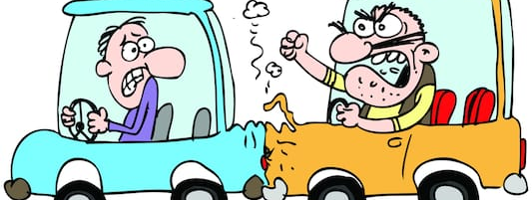
Traffic Accidents
More than 38,000 people die yearly
4.4 million injured enough to require medical attention
Leading cause of death in U.S. for ages 1-54

Slide 3
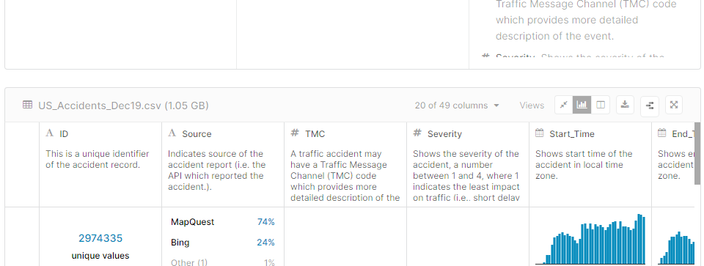
Data Source
Kaggle database
Starting from February 2016
Last updated December 2019

Slide 4

Data Preparation
Very large database
Stored in AWS S3 bucket
Loaded into python notebook using boto3 and pandas
Drop columns with a lot of NaN values

Slide 5

Data Analysis

Slide 6
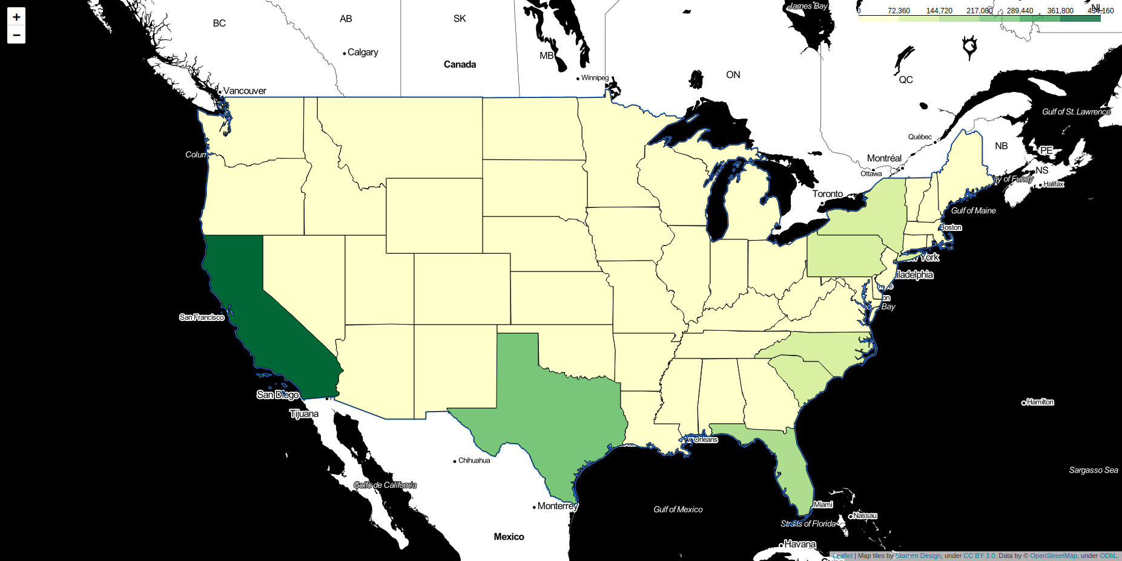
Very similar to population map
Most overshadowed by California
Normalize by number of cars in each state

Slide 7
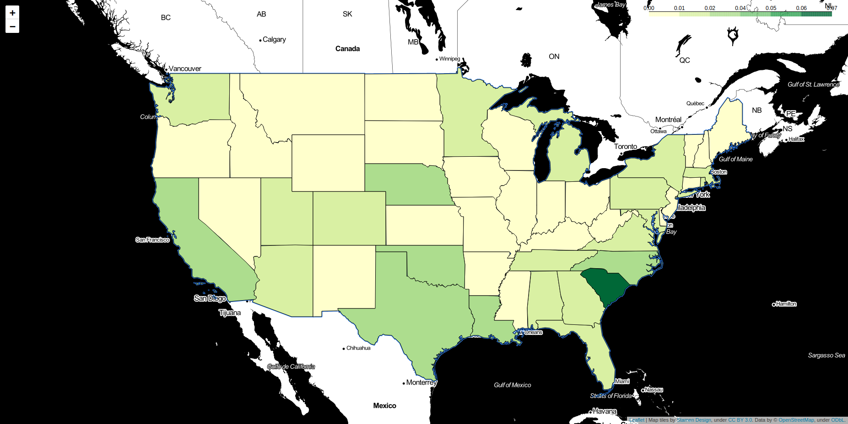
State distribution more apparent
Still somewhat close to population map
What’s going on in South Carolina??

Slide 8
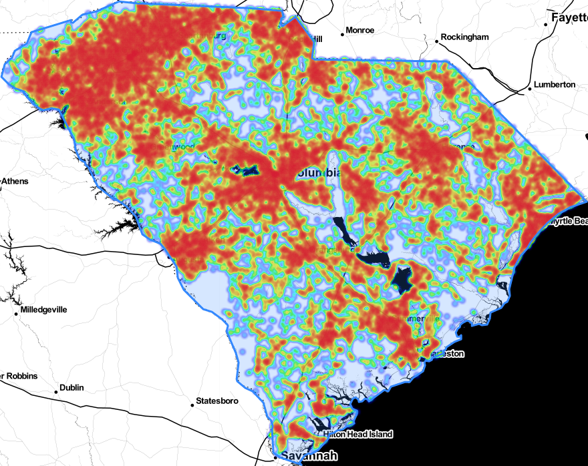
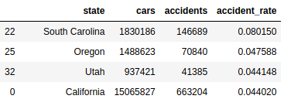
Rate almost doubling next highest
Nothing extraordinary with closer look
Large clusters around major cities

Slide 9
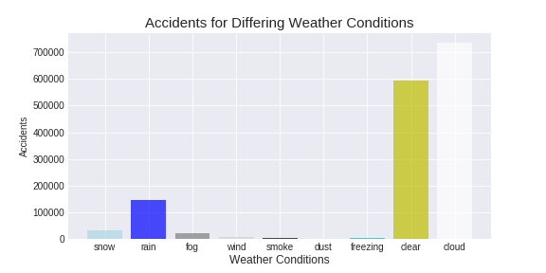
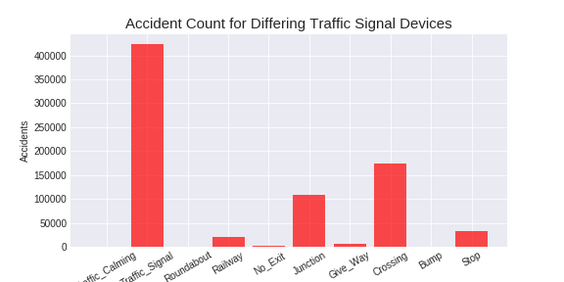
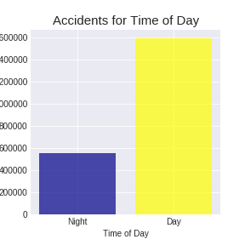
Split data into separate categories and look at their distributions
Most accidents occurring when expected

Slide 10
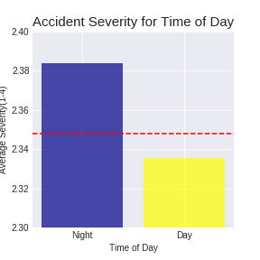
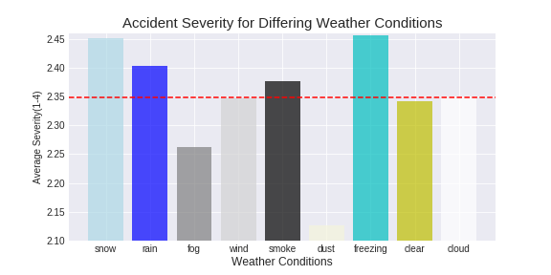
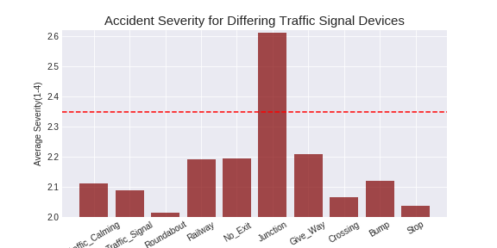
Severities across categories very similar on average
Snow/freezing leading as expected
How significant are these differences?

Slide 11

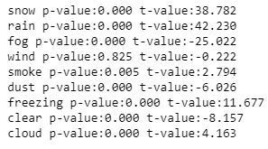
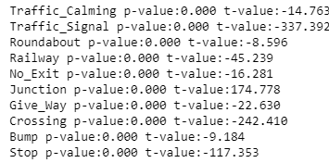
Compared each category against mean
Almost all statistically different despite a small difference

Slide 12

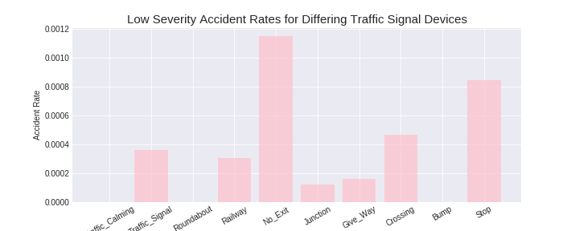
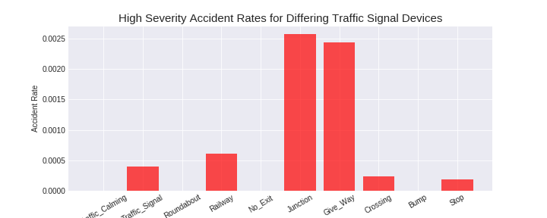
Normalized against total for each device
Leading traffic signal devices as expected for lowest and highest severity

Slide 13

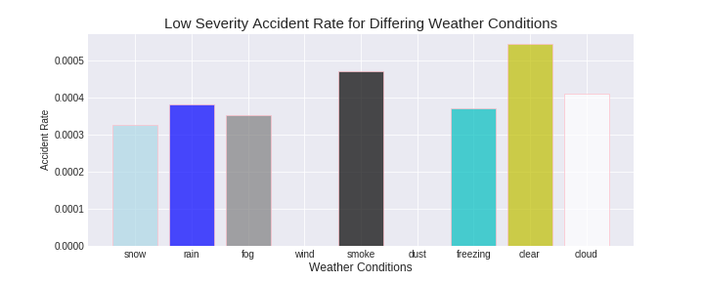
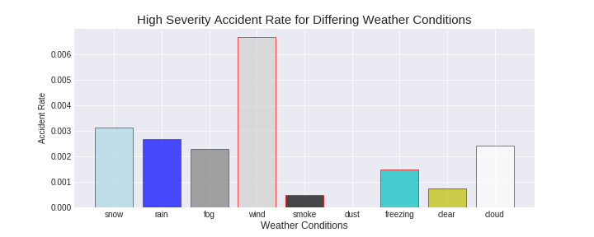
Normalized against total for each weather condition
Low severity highest at clear as expected
High severity highest at wind
Wind not even present for low severity

Slide 14

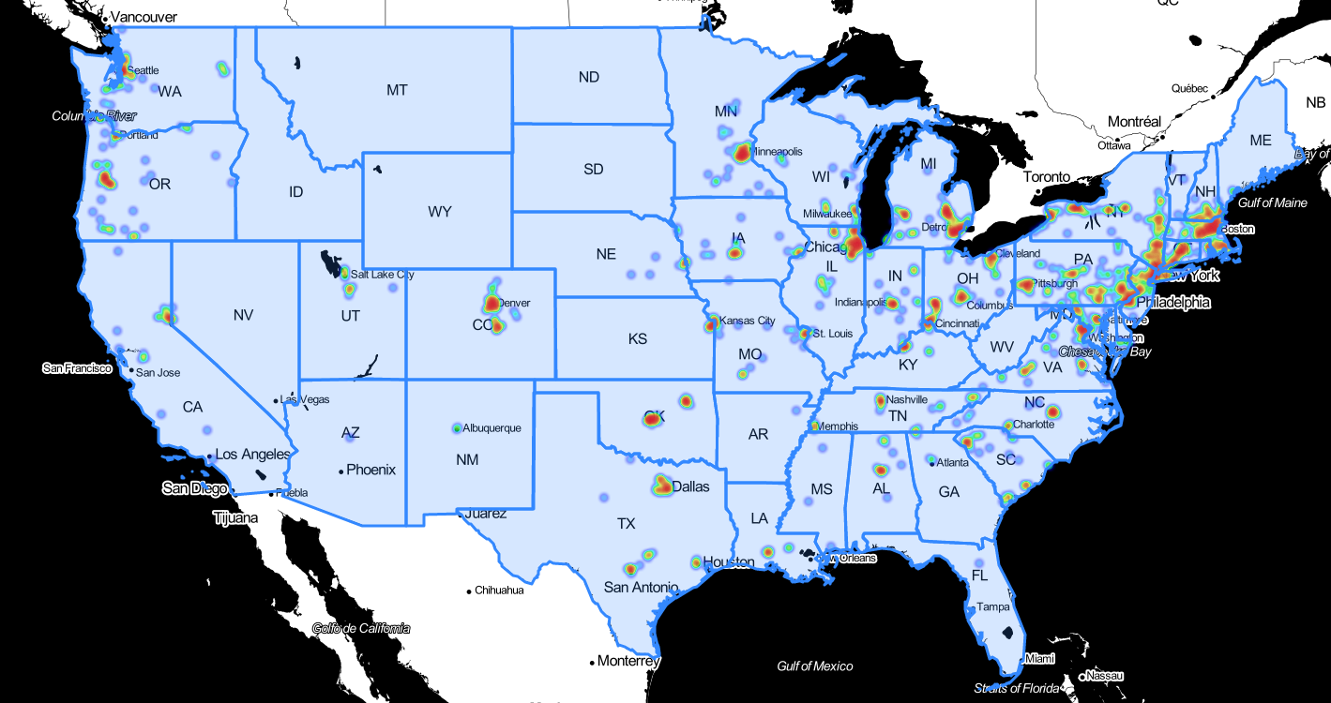
Freezing
Freezing

Slide 15
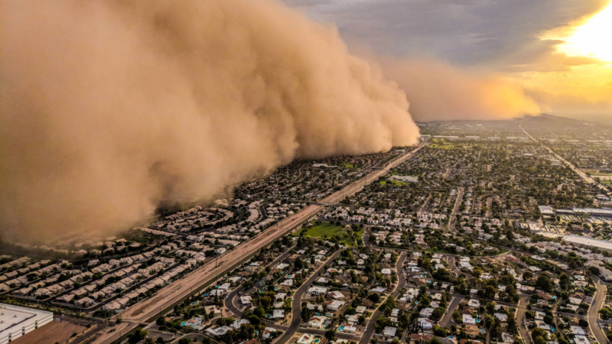
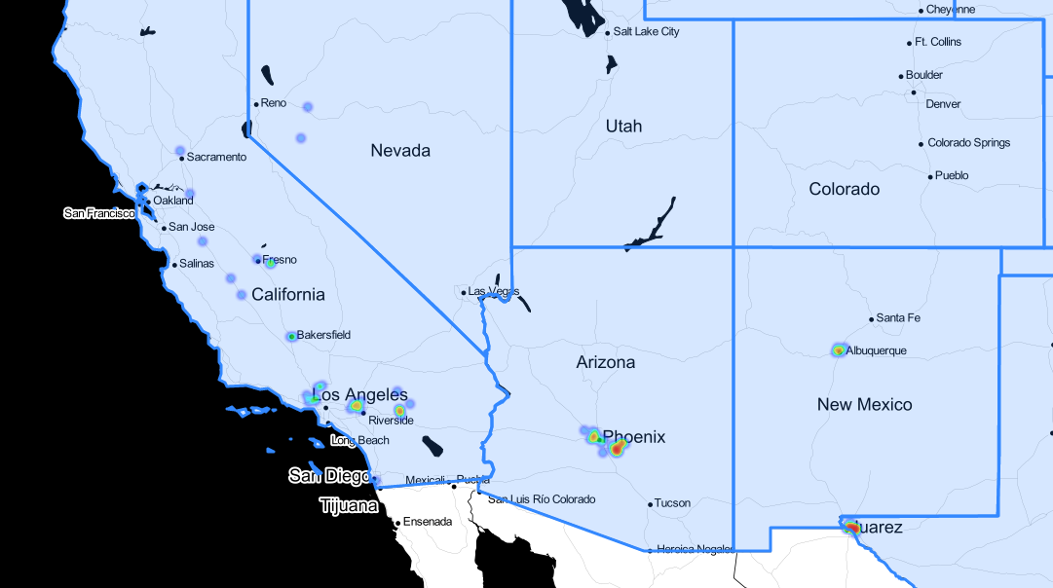
Dust

Slide 16

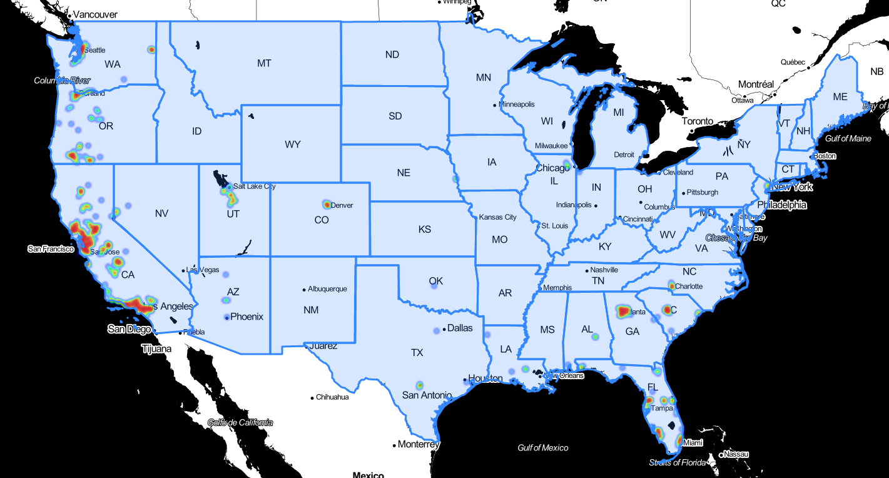
Smoke

Slide 17

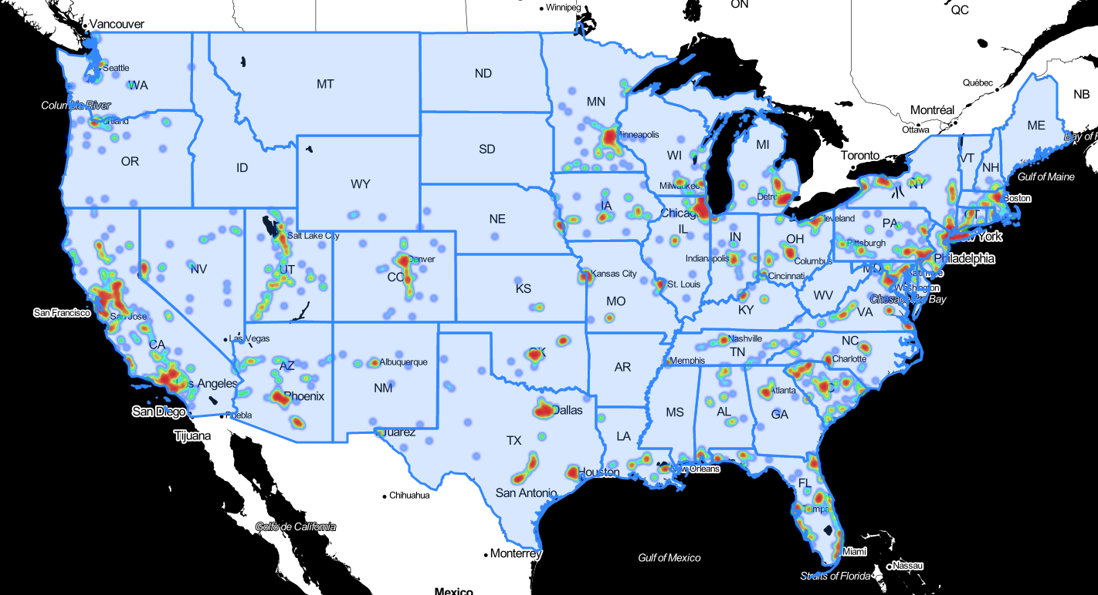
Wind

Slide 18

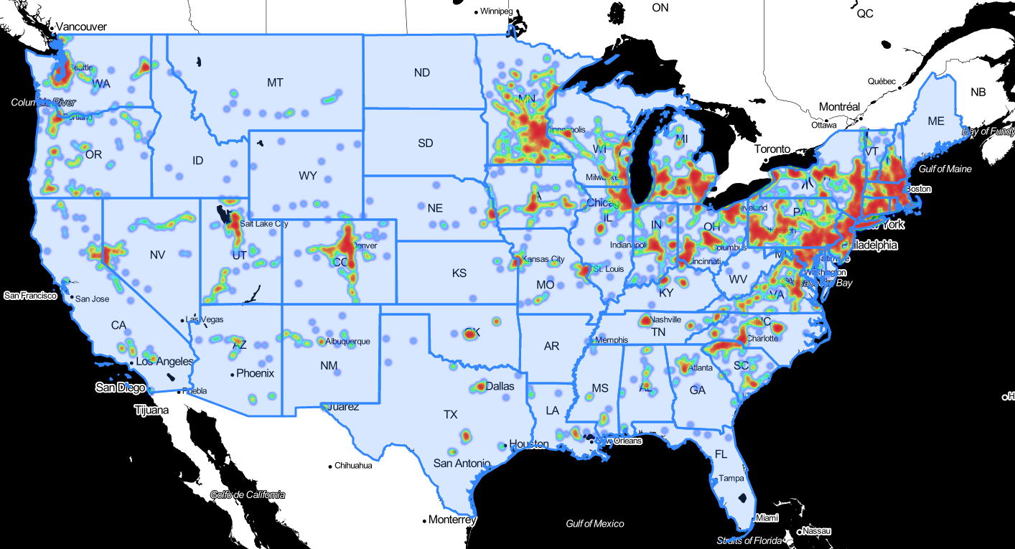
Snow

Slide 19
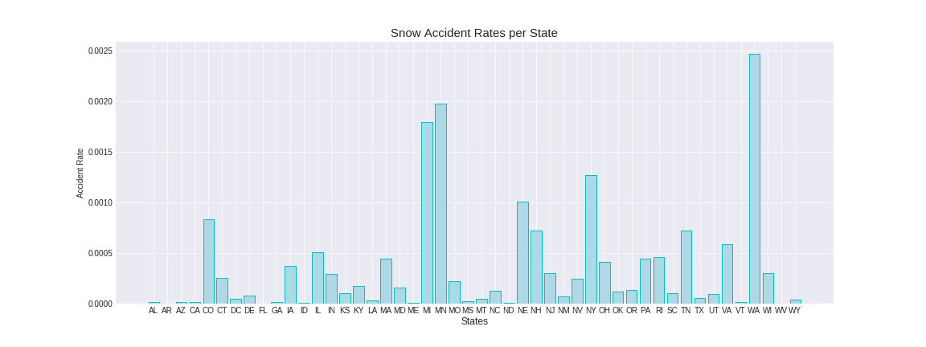
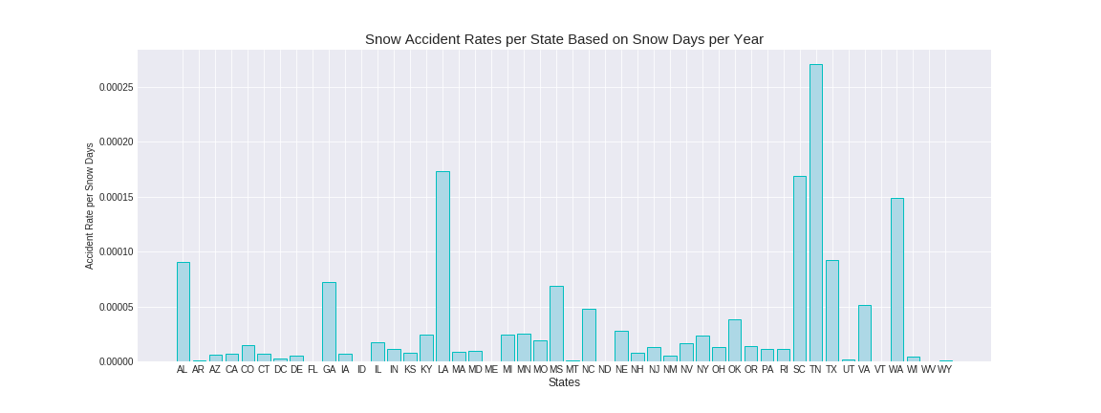
Snow rates higher across states with more snow
Normalized against snow days per year
Low snow states getting into accidents more often

Slide 20

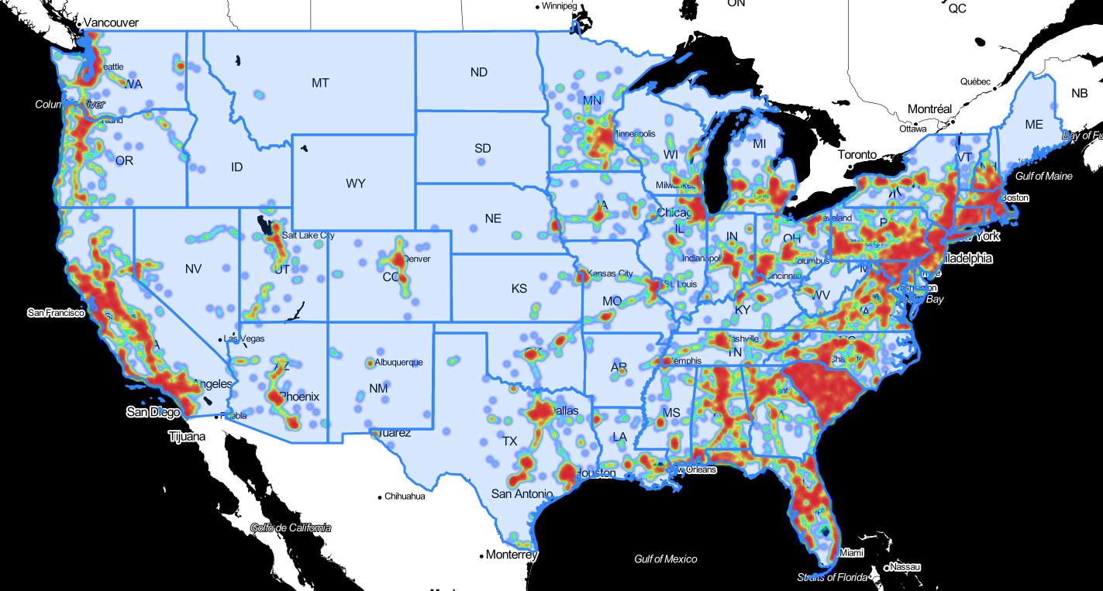
Rain

Slide 21
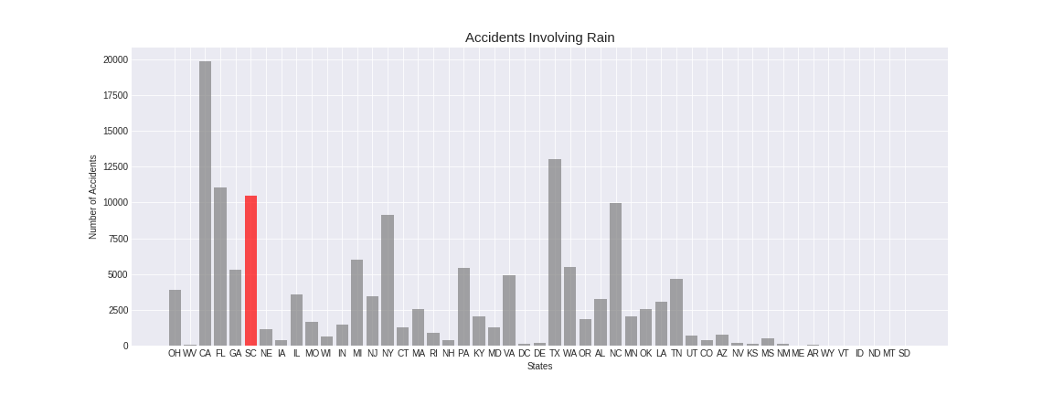
Relatively high
Not extreme enough to explain rate difference

Slide 22

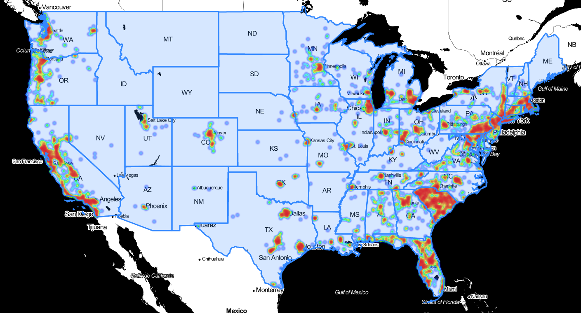
Fog

Slide 23
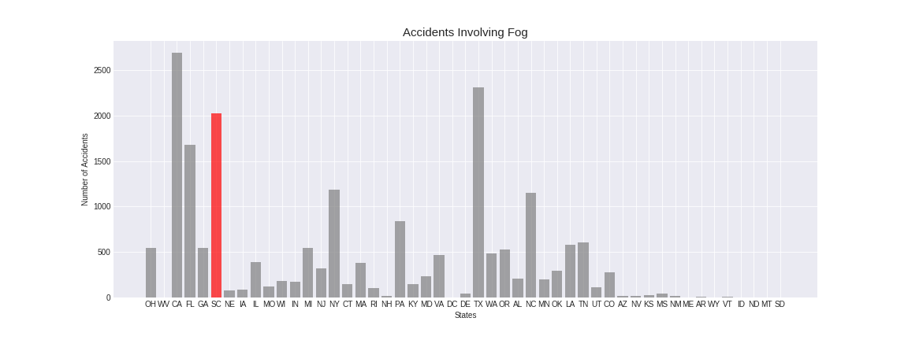
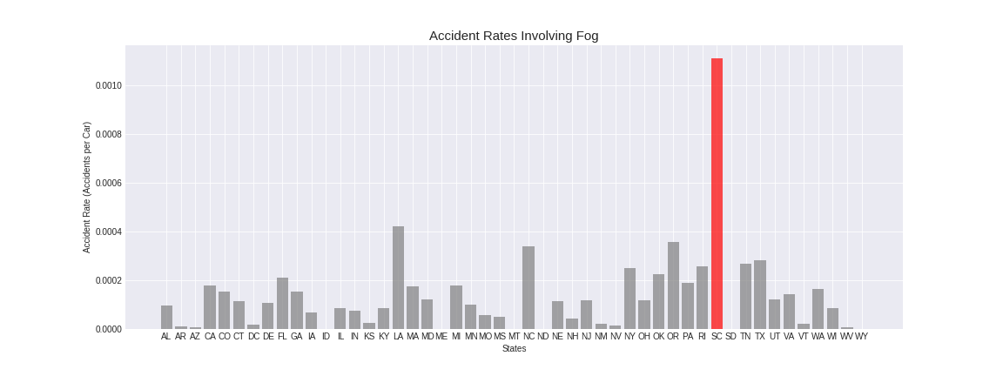
Count was very high despite population size
Rate almost tripling next highest when normalized

Slide 24

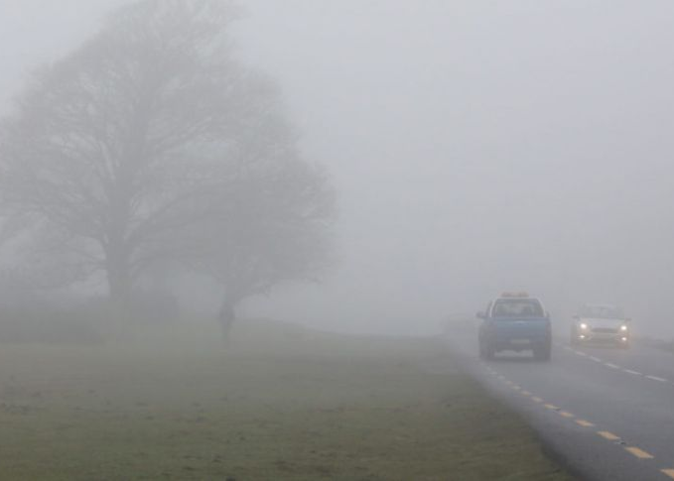
South Carolina
10-20 days of fog per year
Very dense fog
Reckless drivers?

Slide 25

Future Steps
Use data to predict chances of getting into accident under differing conditions
Find safest driving and most dangerous driving conditions

Slide 26
Data Sources
Database: https://www.kaggle.com/sobhanmoosavi/us-accidents
Car Data: https://www.statista.com/statistics/196010/total-number-of-registered-automobiles-in-the-us-by-state/
Snow Data: http://www.usa.com/rank/us--average-snow-days--state-rank.htm

